Slide 1

Simple, open music recommendations
Sam Thursfield, GUADEC 2021

Slide 2

Recommenders are everywhere
@AliceAvizandum, Twitter
Notes:
Think about your day…
What have recommendation algorithms made you do today?
(Buy a product, listen to some music, respond to a social media post, get angry at a stranger, watch a video about lizards running the planet)
Recommendations

Slide 3
Can I make a recommendation algorithm?

Slide 4
Recommendation basics:
data →
process → more data

Slide 5
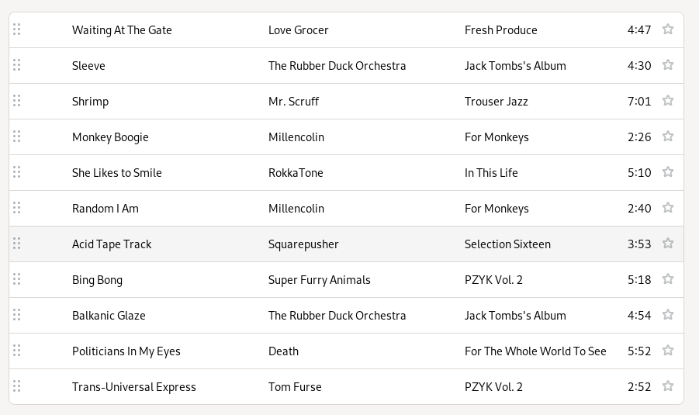

Recommendation basics:
Music collection
Social data
Listen history
Audio analysis
….
→
process →
List of songs

Slide 6
Music recommendation basics:
playlist →
process → playlist

Slide 7
Music recommendation basics:
playlist →
process → playlist
> cpe tracker tracks | cpe shuffle --count 5 - | jq ‘{ title: .title, creator: .creator }’ -c
{"title":"Find the River","creator":"R.E.M."}
{"title":"Good Good Things","creator":"Descendents"}
{"title":"Yuko and Hiro","creator":"Blur"}
{"title":"The Basset Hound’s Lament","creator":"Thomas Truax"}
{"title":"Widowmaker","creator":"The Impossibles"}
cpe = Calliope – set of commandline tools that work with playlists
playlist = list of JSON objects

Slide 8
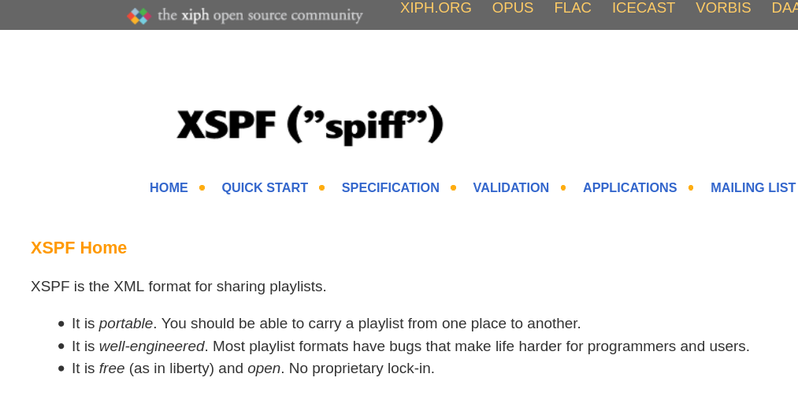
Playlist format
Resolve the playlist in order to listen.

Slide 9
Demo: resolve a playlist
cpe tracker resolve-content five-songs.cpe | jq
You can now export the playlist as .m3u, .xspf, etc.
cpe spotify resolve five-songs.cpe | jq
Requires a free Spotify API key.
You can now upload the playlist to Spotify.

Slide 10
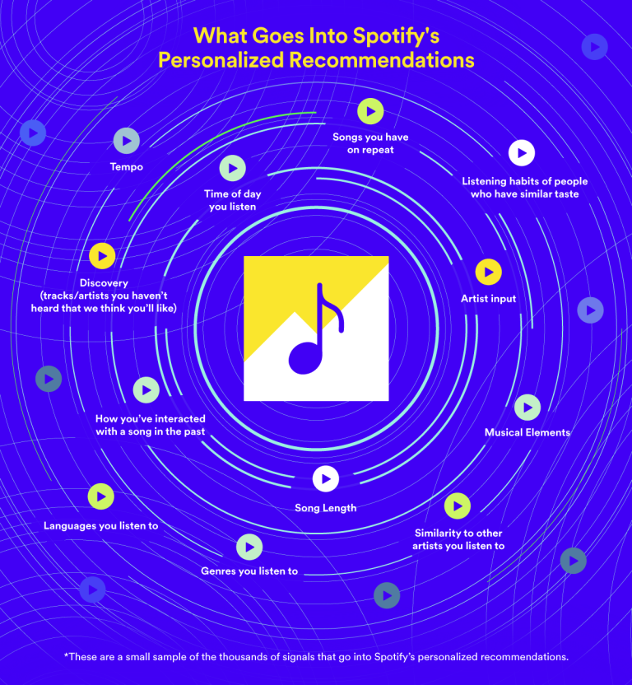
Spotify facts
50 million tracks (25% of which have zero listens)
9000+ data pipelines
1600+ engineers
> half a trillion events captured per day
Source: https://research.atspotify.com/

Slide 11
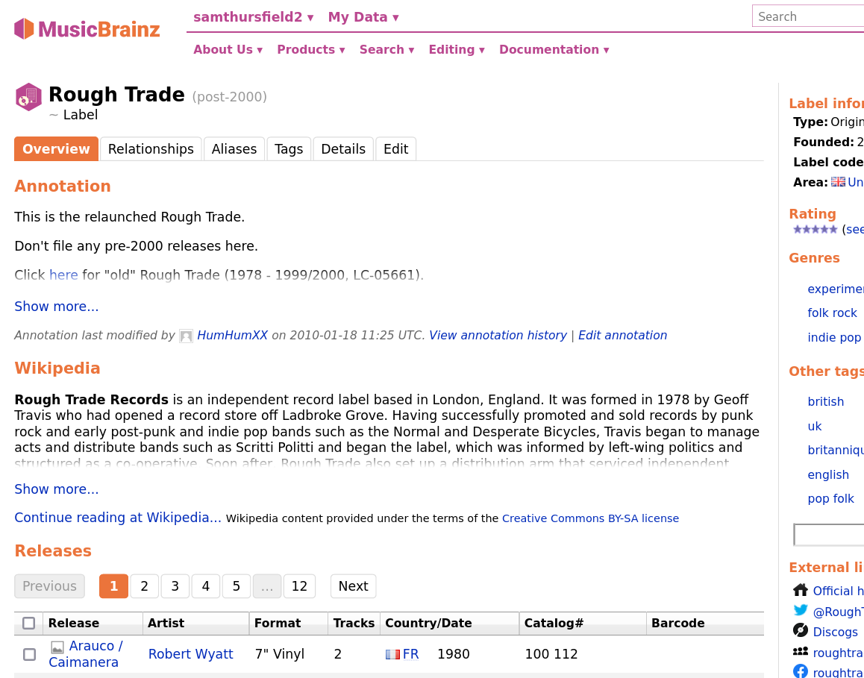
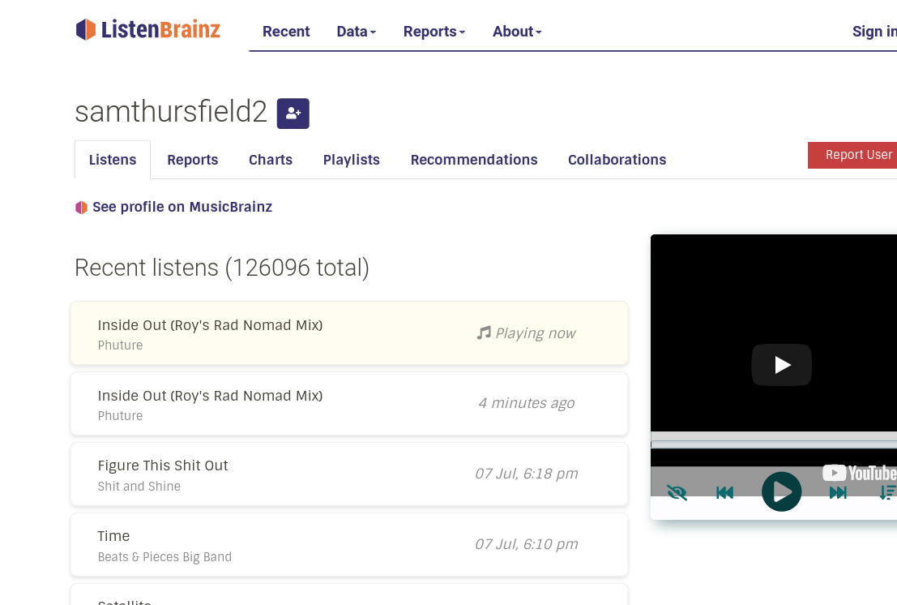
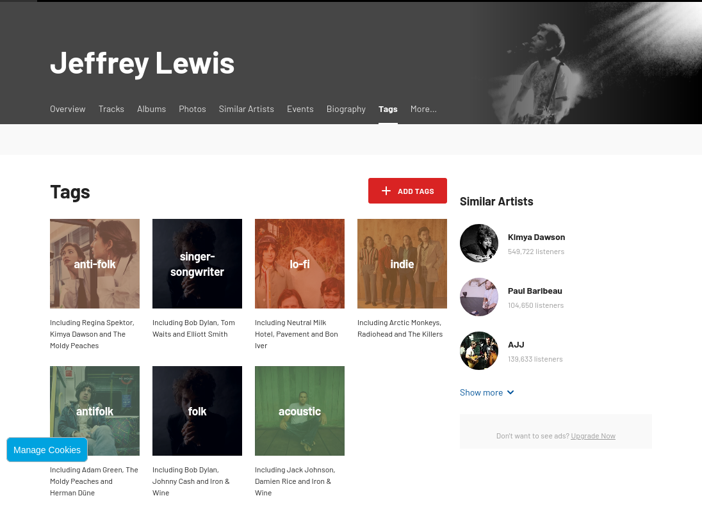
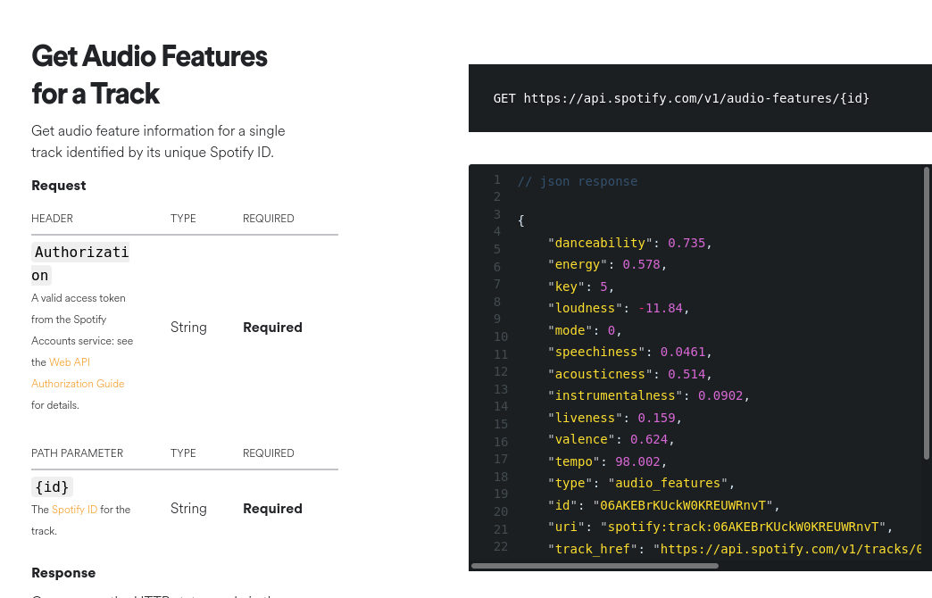
Data sources
MusicBrainz:
metadata
ListenBrainz:
listen history
Last.fm:
tags
listen history
Spotify:
acoustic analysis,
playlists,
listen history
...and many more...

Slide 12
Demo: listening history
cpe -v 3 lastfm-history --user ssam scrobbles | head -n 5
Last 5 tracks I listened to.
cpe lastfm-history artists --first-play-since=’6 months ago’ \
--min-listens 10
Artists I discovered in the last 6 months.
See more examples at: https://calliope-music.readthedocs.io/en/latest/examples/

Slide 13
Demo: ‘forgotten songs’ playlist
cpe lastfm-history tracks --last-play-before=’1 year ago’ \
--min-listens=5 | \
cpe shuffle - --count 20
Now select 30 minutes worth of music:
cpe tracker resolve-content - | cpe select \
--constraint=type:playlist-duration,vmin:30m,vmax:30m - | \ cpe export --format=m3u -
See more examples at: https://calliope-music.readthedocs.io/en/latest/examples/

Slide 14
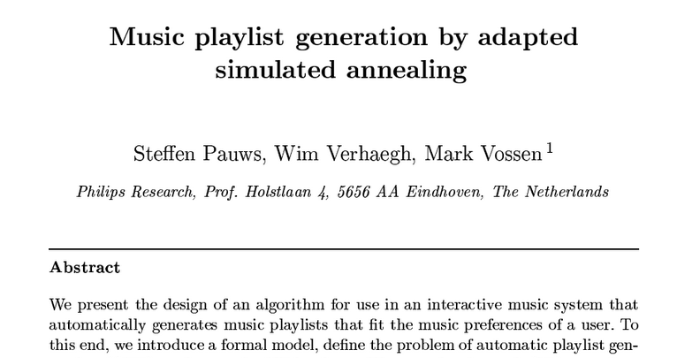
Constraint-based local search
February 2008 Information Sciences 178(3):647-662
https://www.researchgate.net/publication/223327847_Music_playlist_generation_by_adapted_simulated_annealing

Slide 15
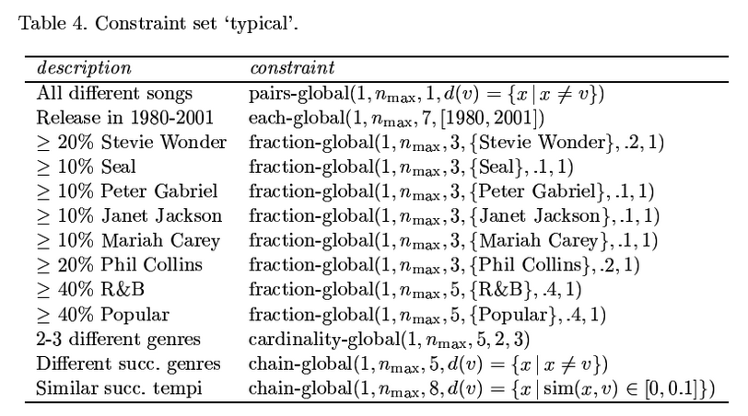
Constraint-based local search
cat tracks.cpe | cpe shuffle - | cpe select \
--constraint=type:playlist-duration,vmin:60m,vmax:120m \
--constraint=type:item-duration,vmin:0s,vmax:6m - > playlist.cpe
simpleai: https://pypi.org/project/simpleai/

Slide 16

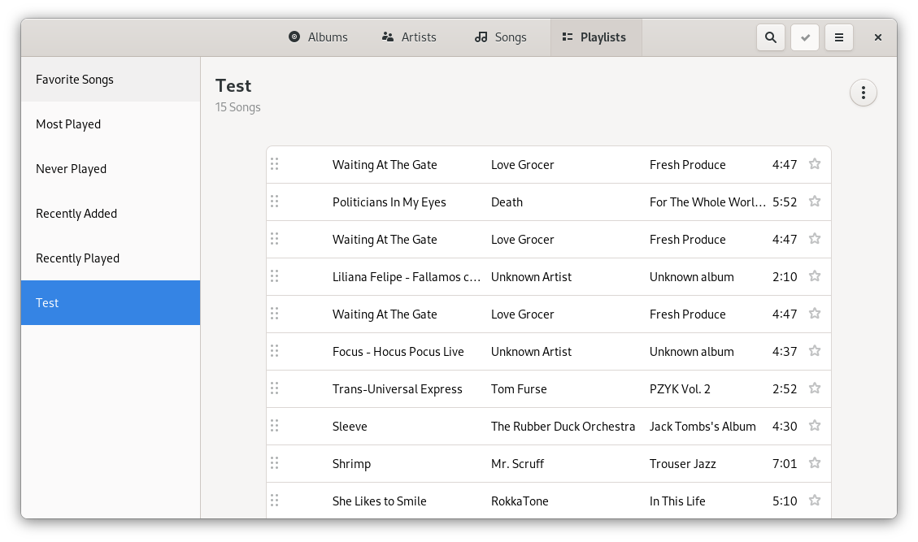
GNOME Music Ideas
Listenbrainz integration
Link to music download sites
Automatic Musicbrainz tagging
Show artist info and links
Suggest ‘artists you might like’
Generate recommendation playlists

Slide 17
Summary
Recommenders are here to stay.
Calliope lets you build lo-fi music recommendations… and more.
https://calliope-music.readthedocs.io/
https://gitlab.com/samthursfield/calliope/
pip install calliope-music
Same design can work for developing other recommenders: videos, web history, suggested apps, local files...

Slide 18
Thanks for watching!

Slide 20
Spotify facts
1600+ engineers
> half a trillion events captured per day
9000+ data pipelines
50 million tracks (25% of which have zero listens)
Drives an increase in people listening to new music and new genres
Drives a reduction in filesharing
Pays artists (much more than Apple Music)
Reduced payment-per-stream 0.008¢ to 0.003¢ in last 6 years
Links:
https://research.atspotify.com/publication/
https://www.youtube.com/watch?v=MXudOLStaXA (Should We Hate Spotify? [An Objective View From A Professional Musician])
https://audioxide.com/articles/how-spotify-has-changed-the-way-we-listen-to-music/

Slide 21
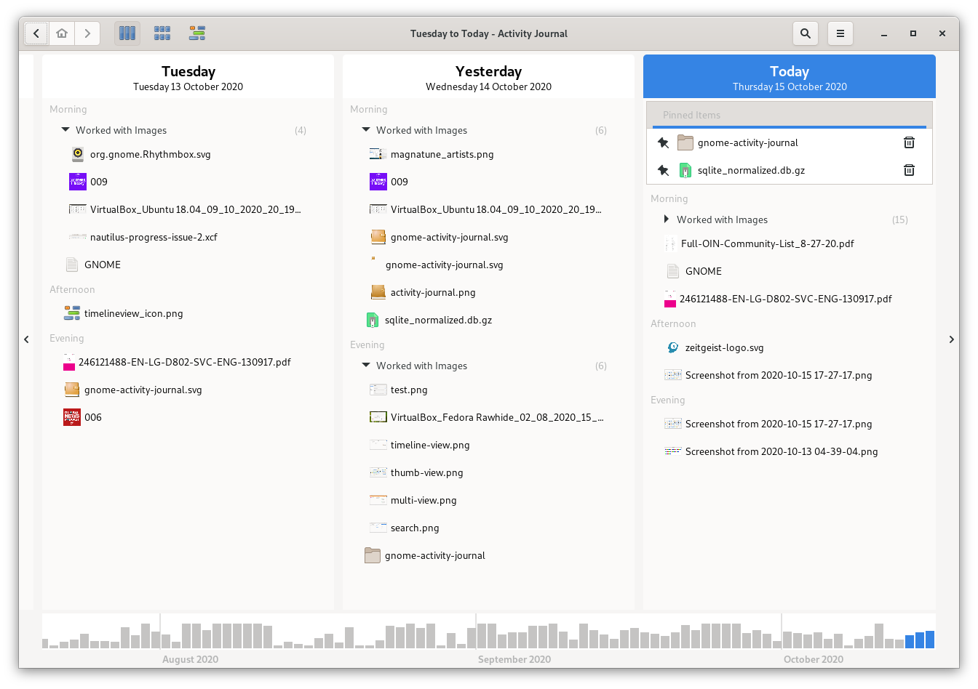
Recommendations in GNOME ...
Recent files dialog
Activity Journal
???

Slide 22
Data is available
Collections: local data, Spotify, Bandcamp, …
Playlists: local data, Youtube, Spotify, Hype Machine, ...
Audio analysis: Spotify, Acousticbrainz
Classification: Last.fm, Every Noise at Once, Spotify
Listen history: Listenbrainz, Last.fm, ...
Metadata: MusicBrainz, Discogs, ...

Slide 23
Demo: 1 hour shuffle mix
jq < tracks.cpe -C | less -R
cat tracks.cpe | cpe shuffle - | cpe select \
--constraint=type:playlist-duration,vmin:60m,vmax:120m \
--constraint=type:item-duration,vmin:0s,vmax:6m - > playlist.cpe
head -n 5 playlist.cpe
cpe export --format=xspf playlist.cpe | head -n 20
https://asciinema.org/a/XXn2Ew7q8NDB5KvSJh6eRxZq2

Slide 24
Other ideas
Backup playlists from Youtube / Spotify
Sync music to phone / iPod
...

Slide 25
Recommended reading
Reverse engineering how TikTok algorithm works, Veed.io, 2020
How Spotify’s Algorithm Knows Exactly What You Want to Listen To, Dave Gershgorn, 2019
Recommending music on Spotify with deep learning, Sander Dieleman, 2014
Brainstorming a better YouTube recommendation algorithm, Francis Irving, 2018
The history of Amazon’s recommendation algorithm, amazon.science, 2019

